Slide 1
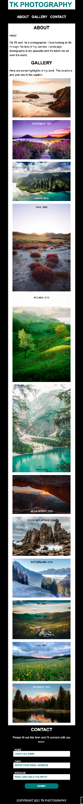
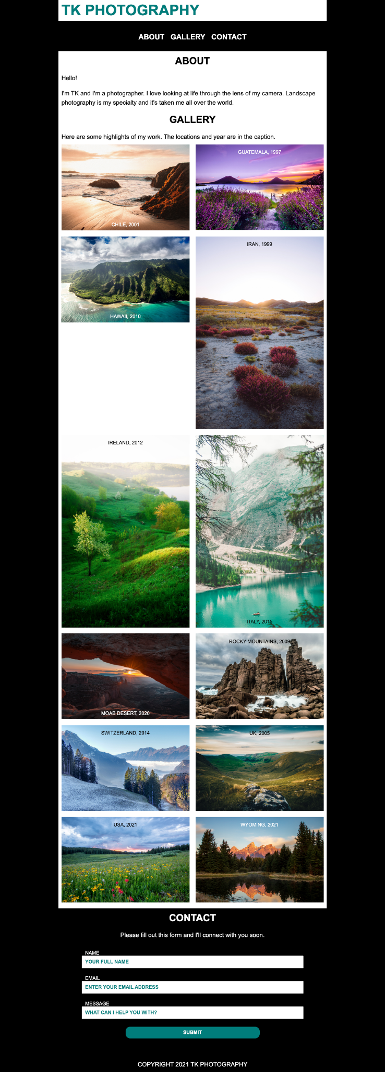
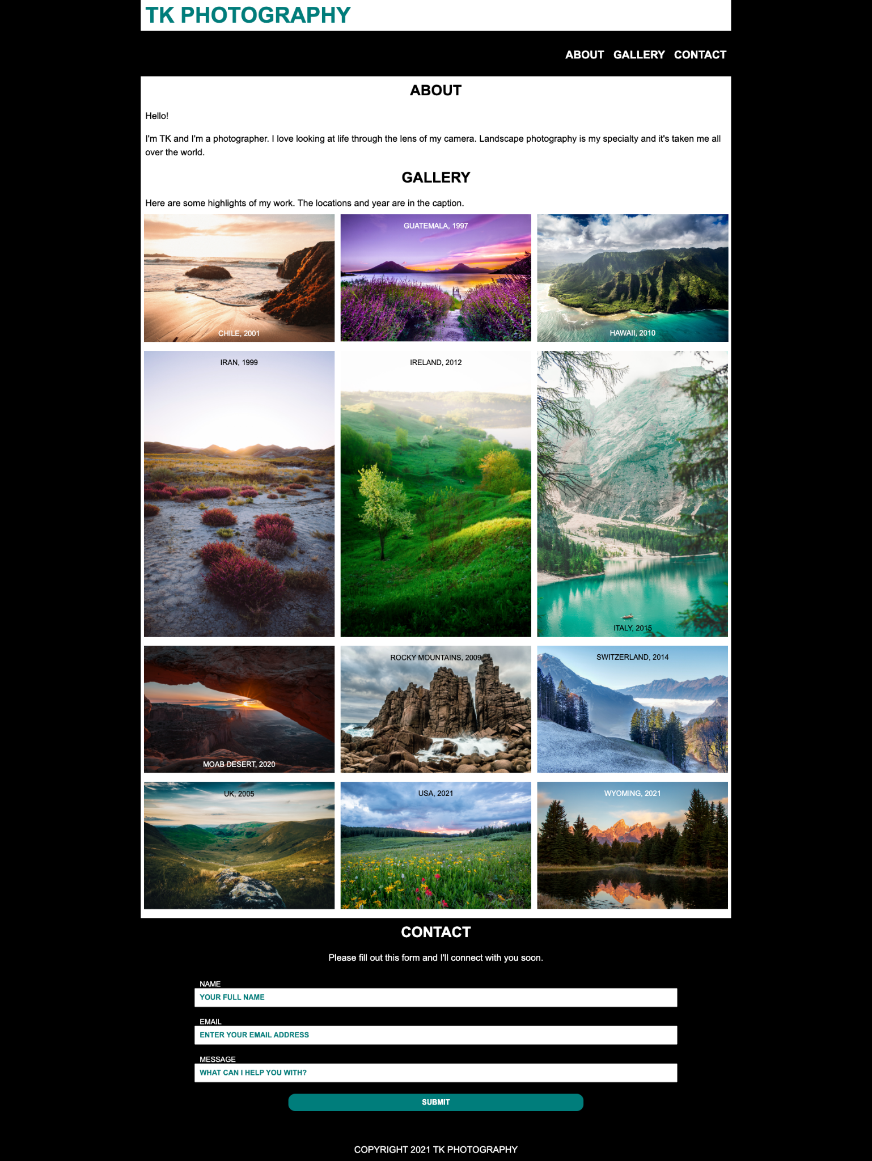
485px
880px
1300px
Content justified center
Content justified right
1 column layout
2 column layout
3 column layout

Slide 2
Color Palette
#007d7b
#000000
#ffffff

Slide 3
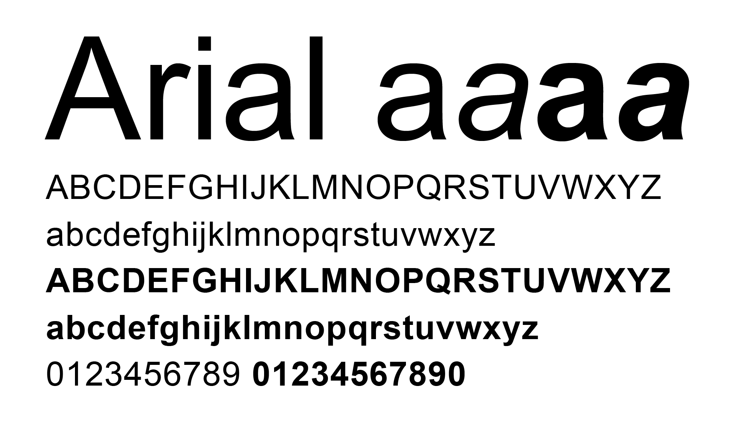
Typography
font-family: Arial, Helvetica, sans-serif;

Slide 4
Font Sizes
p {font-size: 1.25em;}
figcaption, label, input, small {font-size: 1em;}
nav a {font-size: 1.5em;}
h1 {font-size: 3em;}
h2 {font-size: 2em;}

